Slide 1

Course Teacher: Prof. Dr. Israt Jahan

Slide 2
Basic Features
8086 announced in 1978; 8086 is a 16 bit
microprocessor with a 16 bit data bus
8088 announced in 1979; 8088 is a 16 bit
microprocessor with an 8 bit data bus
Both manufactured using High-performance
Metal Oxide Semiconductor (HMOS) technology
Both contain about 29000 transistors
Both are packaged in 40 pin dual-in-line package (DIP)

Slide 3

GND
1
40
VCC
AD14
2
39
AD15
AD13
3
38
A16/S3
AD12
4
37
A17/S4
AD11
5
36
A18/S5
AD10
6
35
A19/S6
AD9
7
34
BHE/S7
AD8
8
8086
33
MN/MX
AD7
9
32
RD
AD6
10
31
HOLD
AD5
11
30
HLDA
AD4
12
29
WR
AD3
13
28
M/IO
AD2
14
27
DT/R
AD1
15
26
DEN
AD0
16
25
ALE
NMI
17
24
INTA
INTR
18
23
TEST
CLK
19
22
READY
GND
20
21
RESET

Slide 4
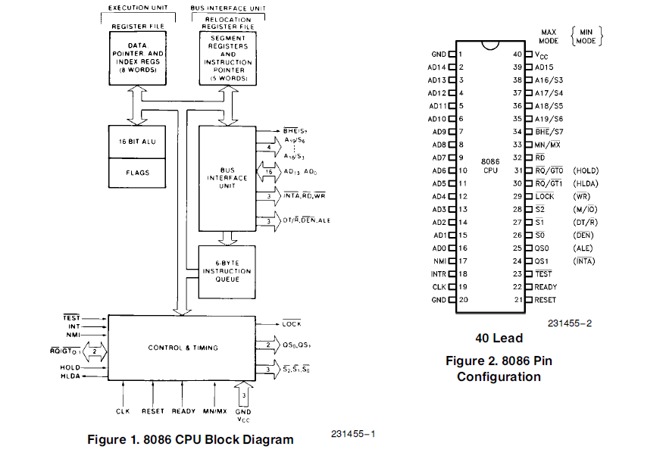

Slide 5
Minimum-mode and Maximum-mode Systems
8086 microprocessors can be configured to work in either of the two modes: the minimum mode and the maximum mode
Minimum mode:
  Pull MN/MX to logic 1
  Typically smaller systems and contains a single microprocessor
  Cheaper since all control signals for memory and I/O are generated by the microprocessor.
Maximum mode
  Pull MN/MX logic 0
  Larger systems with more than one processor (designed to be used when a coprocessor (8087) exists in the system)
GND
1
40
VCC
AD14
2
39
AD15
AD13
3
38
A16/S3
AD12
4
37
A17/S4
AD11
5
36
A18/S5
AD10
6
35
A19/S6
AD9
7
34
BHE/S7
AD8
8
8086
33
MN/MX
AD7
9
32
RD
AD6
10
31
HOLD
AD5
11
30
HLDA
AD4
12
29
WR
AD3
13
28
M/IO
AD2
14
27
DT/R
AD1
15
26
DEN
AD0
16
25
ALE
NMI
17
24
INTA
INTR
18
23
TEST
CLK
19
22
READY
GND
20
21
RESET
Lost Signals in
Max Mode

Slide 6
Minimum-mode and Maximum-mode Signals
GND
1
40
VCC
GND
1
40
VCC
AD14
2
39
AD15
AD14
2
39
AD15
AD13
3
38
A16/S3
AD13
3
38
A16/S3
AD12
4
37
A17/S4
AD12
4
37
A17/S4
AD11
5
36
A18/S5
AD11
5
36
A18/S5
AD10
6
35
A19/S6
AD10
6
35
A19/S6
AD9
7
34
BHE/S7
Vcc
AD9
7
34
BHE/S7
GND
AD8
8
8086
33
MN/MX
AD8
8
8086
33
MN/MX
AD7
9
32
RD
AD7
9
32
RD
AD6
10
31
HOLD
AD6
10
31
RQ/GT0
AD5
11
30
HLDA
AD5
11
30
RQ/GT1
AD4
12
29
WR
AD4
12
29
LOCK
AD3
13
28
M/IO
AD3
13
28
S2
AD2
14
27
DT/R
AD2
14
27
S1
AD1
15
26
DEN
AD1
15
26
S0
AD0
16
25
ALE
AD0
16
25
QS0
NMI
17
24
INTA
NMI
17
24
QS1
INTR
18
23
TEST
INTR
18
23
TEST
CLK
19
22
READY
CLK
19
22
READY
GND
20
21
RESET
GND
20
21
RESET
Min Mode
Max Mode

Slide 7
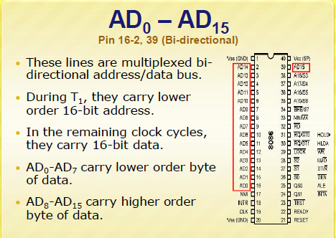

Slide 8
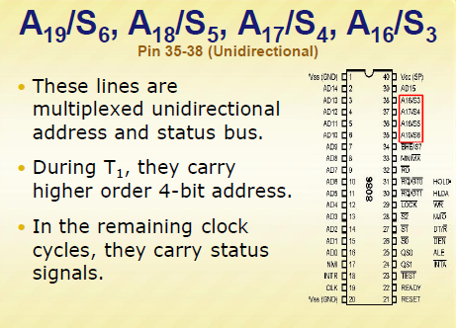

Slide 9
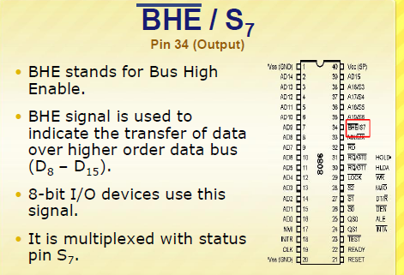

Slide 10
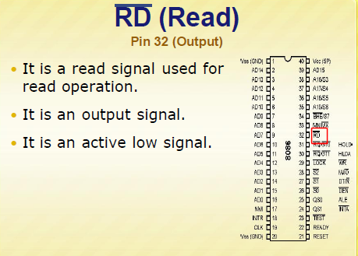

Slide 11
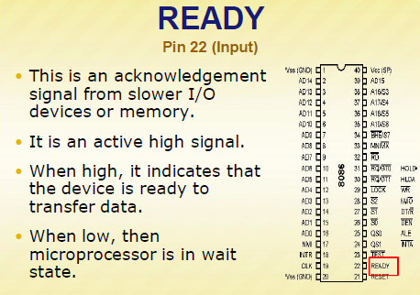

Slide 12
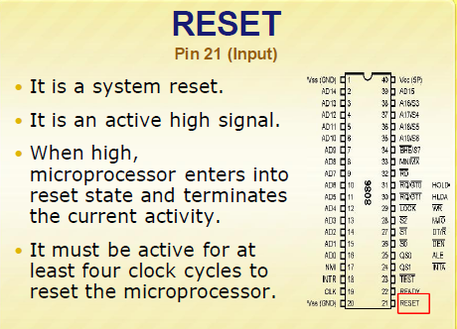

Slide 13
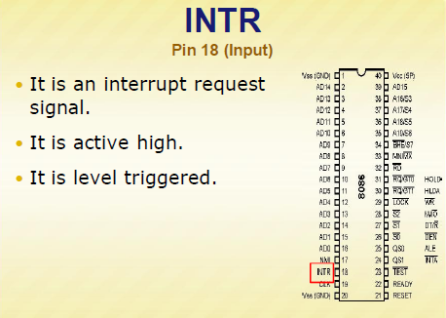

Slide 14
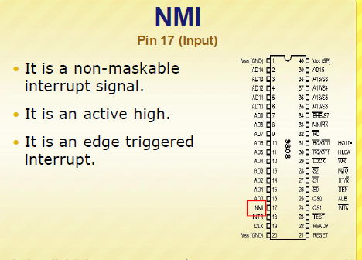

Slide 15
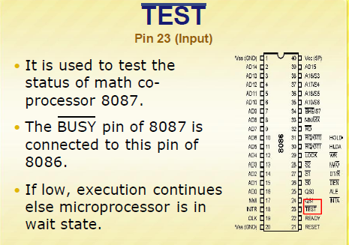

Slide 16
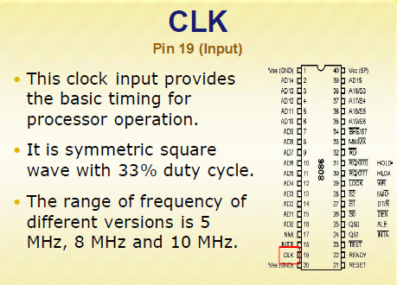

Slide 17
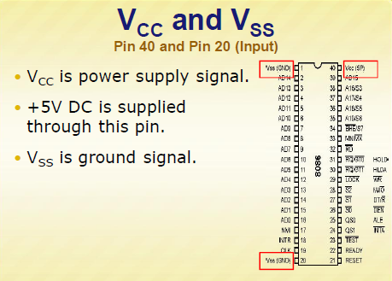

Slide 18


Slide 19
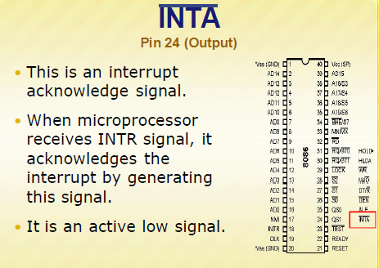

Slide 20
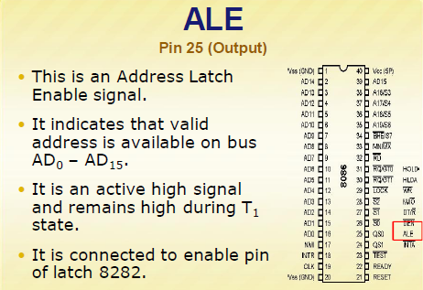

Slide 21
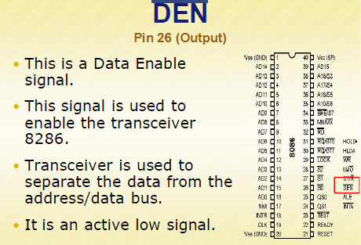

Slide 22
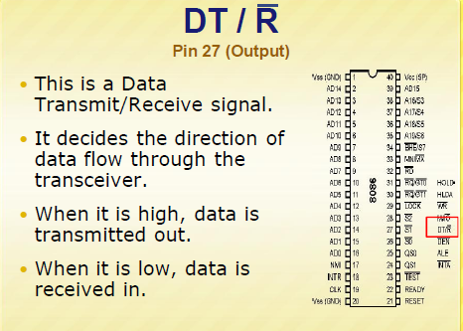

Slide 23
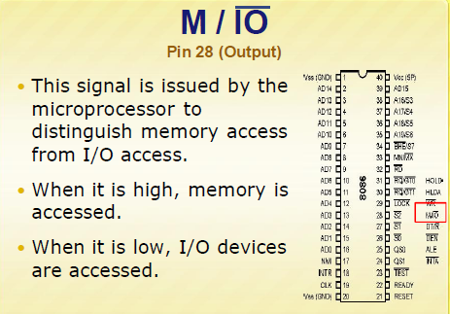

Slide 24
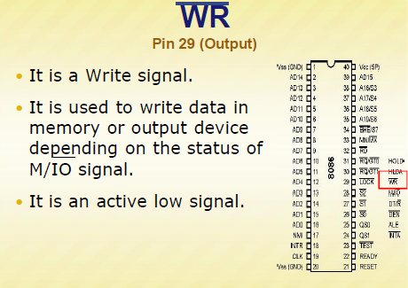

Slide 25
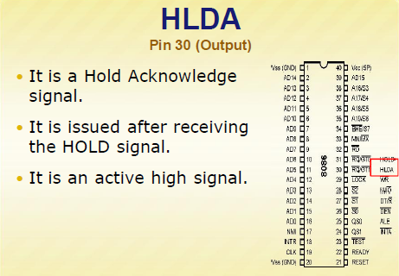

Slide 26
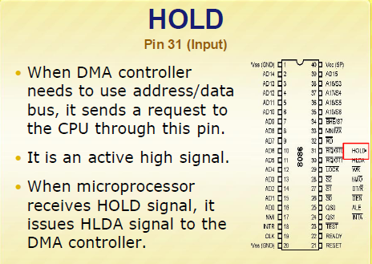

Slide 27


Slide 28
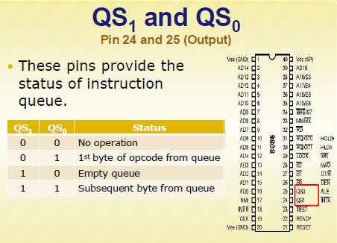

Slide 29
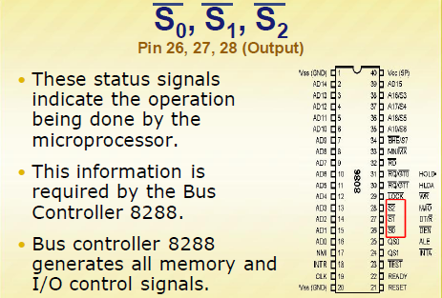

Slide 30
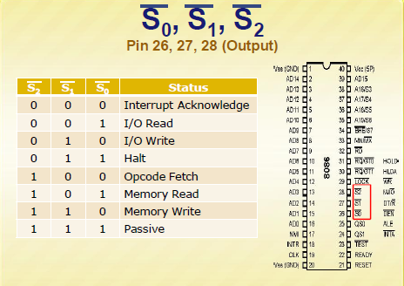

Slide 31
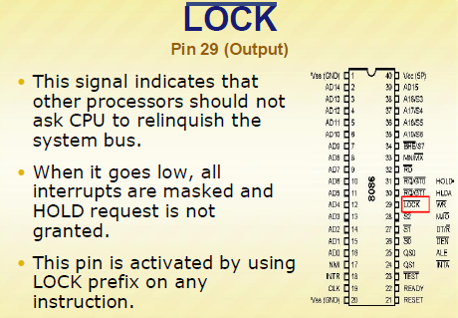

Slide 32
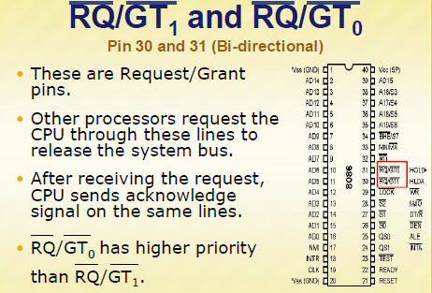

Slide 33
MN/MX is an input pin used to select one of these modes. When MN/MX is HIGH, the 8086 operates in the minimum mode. When MN/MX is LOW, 8086 is configured to support multiprocessor systems. In this case, the Intel 8288 bus controller is added to the 8086 to provide bus controls.
Pins 2 through 16 and 39 (AD15 - AD0) are a 16-bit multiplexed address/data bus. During the first clock cycle AD0-AD15 are the low order 16 bits of address. The 8086 have a total of 20 address lines.
The upper four lines (35 – 38)are multiplexed with the status signals for the 8086. These are the A16/S3, A17/S4, A18/S5, and A19/S6. During the first clock period of a bus cycle, the entire 20-bit address is available on these lines. During all other clock cycles for memory and I/O operations, AD15-AD0 contains the 16-bit data, and S3, S4, S5, and S6 become status lines. S3 and S4 lines are decoded as follows:
A17/S4 A16/S3 Function
0 0 Extra segment
0 1 Stack segment
1 0 Code or no segment
1 1 Data Segment

Slide 34
Status bits S3 and S4 indicate the segment register that is being used to generate the address the address and bit S5 reflects the contents of the IF flag. S6 is always held at 0 and indicates that an 8086 is controlling the system bus.
Pins 1 and 20 are grounded. Pin 17 is NMI. This is the Non Maskable Interrupt input activated by a leading edge. Pin 18 is INTR. INTR is the maskable interrupt input. Pin 19 is CLK is for supplying the clock signal that synchronizes the activity within the CPU.
Pin 21 (RESET) is the system reset input signal. When the 8086 detects the positive going edge of a pulse on RESET, it stops all activities until the signal goes LOW. When the reset is low, the 8086 initializes as follows:

Slide 35
8086 Component Content
Flags Clear
IP 0000H
CS FFFFH
DS 0000H
SS 0000H
ES 0000H
Queue Empty
Pin 22 (READY) is for inputting an acknowledge from a memory or I/O interface that input data will be put on the data bus or output data will be accepted from the data bus within the next clock cycle. In either case, the CPU and its bus control logic can complete the current bus cycle after the next clock cycle.
Pin 23 TEST is an input pin and is only used by the WAIT instruction. The 8086 enter a wait state after execution of the WAIT instruction until a LOW is seen on the TEST pin.

Slide 36
Pins 24 to 31 are mode dependent and are considered later.
Pin 32 (RD) is LOW whenever the 8086 is reading data from memory or an I/O location.
Pin 34 (BHE/S7) is used as BHE (BUS High Enable) during the first clock cycle of an instruction execution. BHE can be used in conjunction with AD0 to select memory banks. During all other clock cycles BHE/S7 is used as S7.
Operation BHE/ AD0 Data pins used
Write/Read a word at an even
Address 0 0 AD15 – AD0
Write/Read a byte at an even
Address 1 0 AD7 – AD0
Write/Read a byte at an odd
Address 0 1 AD15 – AD8
Write/Read a word at an odd
Address 0 1 AD15 – AD8
1 0 AD7 - AD0

Slide 37
Multiplex of Data and Address Lines in 8086
Address lines A0-A15 and Data lines D0-D15 are multiplexed in 8086. These lines are labelled as AD0-AD15.
GND
1
40
VCC
AD14
2
39
AD15
AD13
3
38
A16/S3
AD12
4
37
A17/S4
AD11
5
36
A18/S5
AD10
6
35
A19/S6
AD9
7
34
BHE/S7
AD8
8
8086
33
MN/MX
AD7
9
32
RD
AD6
10
31
HOLD
AD5
11
30
HLDA
AD4
12
29
WR
AD3
13
28
M/IO
AD2
14
27
DT/R
AD1
15
26
DEN
AD0
16
25
ALE
NMI
17
24
INTA
INTR
18
23
TEST
CLK
19
22
READY
GND
20
21
RESET

Slide 38
Minimum-mode and Maximum-mode Systems
8086 microprocessors can be configured to work in either of the two modes: the minimum mode and the maximum mode
Minimum mode:
  Pull MN/MX to logic 1
  Typically smaller systems and contains a single microprocessor
  Cheaper since all control signals for memory and I/O are generated by the microprocessor.
Maximum mode
  Pull MN/MX logic 0
  Larger systems with more than one processor (designed to be used when a coprocessor (8087) exists in the system)
GND
1
40
VCC
AD14
2
39
AD15
AD13
3
38
A16/S3
AD12
4
37
A17/S4
AD11
5
36
A18/S5
AD10
6
35
A19/S6
AD9
7
34
BHE/S7
AD8
8
8086
33
MN/MX
AD7
9
32
RD
AD6
10
31
HOLD
AD5
11
30
HLDA
AD4
12
29
WR
AD3
13
28
M/IO
AD2
14
27
DT/R
AD1
15
26
DEN
AD0
16
25
ALE
NMI
17
24
INTA
INTR
18
23
TEST
CLK
19
22
READY
GND
20
21
RESET
Lost Signals in
Max Mode

Slide 39
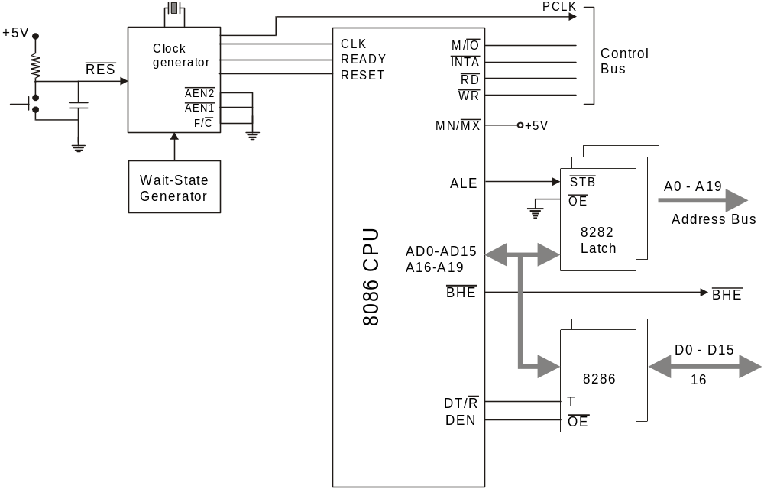
8086 System Minimum mode

Slide 40
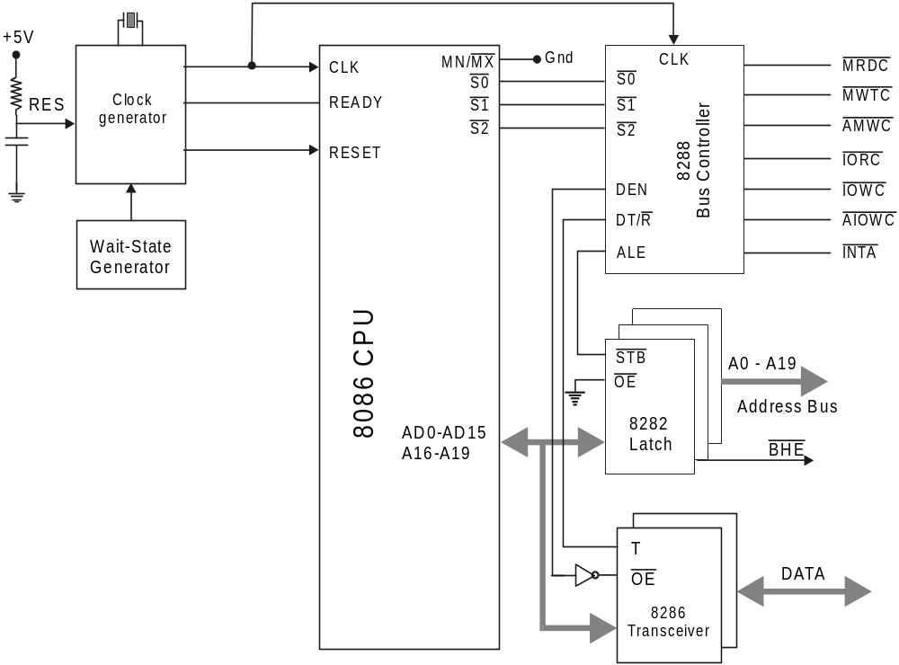
8086 System Maximum Mode

Slide 41
RESET Operation results
CPU component | Contents
Flags | Cleared
Instruction Pointer | 0000H
CS | FFFFH
DS, SS and ES | 0000H
Queue | Empty

Slide 42
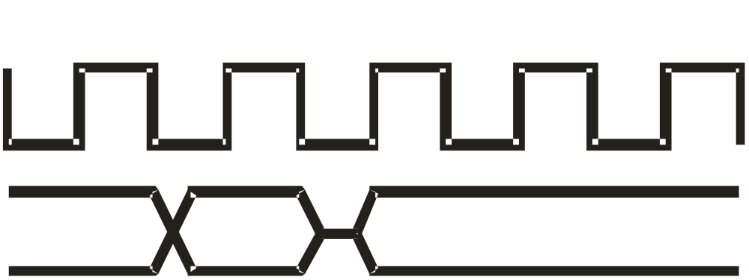
AD0 - AD15: Address Data Bus
Data
AD0 – AD15
Address

Slide 43
A17/S4, A16/S3 Address/Status
A17/S4 | A16/S3 | Function
0 | 0 | Extra segment access
0 | 1 | Stack segment access
1 | 0 | Code segment access
1 | 1 | Data segment access

Slide 44
A19/S6, A18/S5 Address/Status
A18/S5: The status of the
interrupt enable flag bit is updated
at the beginning of each cycle. The status of the flag is indicated through this pin
A19/S6: When Low, it indicates that 8086 is in control of the bus. During a "Hold acknowledge" clock period, the 8086 tri-states the S6 pin and thus allows another bus master to take control of the status bus.

Slide 45
S0, S1 and S2 Signals
S2 | S1 | S0 | Characteristics
0 | 0 | 0 | Interrupt acknowledge
0 | 0 | 1 | Read I/O port
0 | 1 | 0 | Write I/O port
0 | 1 | 1 | Halt
1 | 0 | 0 | Code access
1 | 0 | 1 | Read memory
1 | 1 | 0 | Write memory
1 | 1 | 1 | Passive State

Slide 46
QS1 and QS2 Signals
QS1 | QS1 | Characteristics
0 | 0 | No operation
0 | 1 | First byte of opcode from queue
1 | 0 | Empty the queue
1 | 1 | Subsequent byte from queue

Slide 47
INTR (input)
Hardware Interrupt Request Pin
INTR is used to request a hardware interrupt.
It is recognized by the processor only when IF = 1, otherwise it is ignored (STI instruction sets this flag bit).
The request on this line can be disabled (or masked) by making IF = 0 (use instruction CLI)
If INTR becomes high and IF = 1, the 8086 enters an interrupt acknowledge cycle (INTA becomes active) after the current instruction has completed execution.

Slide 48
NMI (input) Non-Maskable Interrupt line
The Non Maskable Interrupt input is similar to INTR except that the NMI interrupt does not check to see if the IF flag bit is at logic 1.
This interrupt cannot be masked (or disabled) and no acknowledgment is required.
It should be reserved for “catastrophic” events such as power failure or memory errors.

Slide 49
TEST (input)
The TEST pin is an input that is tested by the WAIT instruction.
If TEST is at logic 0, the WAIT instruction functions as a NOP.
If TEST is at logic 1, then the WAIT instruction causes the 8086 to idle, until TEST input becomes a logic 0.
This pin is normally driven by the 8087 co-processor (numeric coprocessor) .
This prevents the CPU from accessing a memory result before the NDP has finished its calculation

Slide 50
Ready (input)
This input is used to insert wait states into processor Bus Cycle.
If the READY pin is placed at a logic 0 level, the microprocessor enters into wait states and remains idle.
If the READY pin is placed at a logic 1 level, it has no effect on the operation of the processor.
It is sampled at the end of the T2 clock pulse
Usually driven by a slow memory device

Slide 51
HOLD (input)
The HOLD input is used by DMA controller to request a Direct Memory Access (DMA) operation.
If the HOLD signal is at logic 1, the microprocessor places its address, data and control bus at the high impedance state.
If the HOLD pin is at logic 0, the microprocessor works normally.

Slide 52
HLDA (output)
Hold Acknowledge Output
Hold acknowledge is made high to indicate to the DMA controller that the processor has entered hold state and it can take control over the system bus for DMA operation.

